Slide 1

Beyond Tactical DDD. CQS, CQRS, Event Sourcing...

Slide 2

Event Sourcing
Created by Greg Young. Greg Young's Blog
It is a persistence philosophy where the data that is stored as our source of truth are there resulting events of the execution of our actions/use cases
The idea is to hold a database that stores our events and from there create different projections of the data according the problem we are facing

Slide 3
Event Sourcing
Storing only snapshots have great limitations:
Is not possible to understand how the current state became like it is.
Lack of visibility of the flow that some actor in your system.
Process granularity is out of question. It is impossible to take the data at some point of the past and recreate the application state at some point of the time.

Slide 4
Event Sourcing
State transitions are important and should be an explicit part of our model. They are facts. Facts are the representation of the execution of our actions or use cases.
Current state usually is not the important thing. How did you end up on that state is what matters.
They are transient. It is possible to go forward and backwards on the current state, delete it state and rebuild it from the facts.
Database Cargo Cult focus on creating a thoughtful data structure but lacks on using data in the appropriate way for every problem

Slide 5
Event Sourcing
Facts should not be deleted, but corrected. We preserve the mistakes, create a correction reversing the fact and execute the use case the way we wanted initially.
We store the facts using our domain events. And those events are immutable, they do not change at any point of the time once they are persisted.
Our domain events are our single source of truth. And from them the state can be rebuild and our query model (views or projections) come to life.

Slide 6
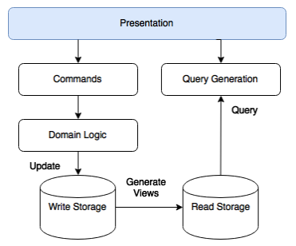
Event Sourcing: A classic implementation

Slide 7
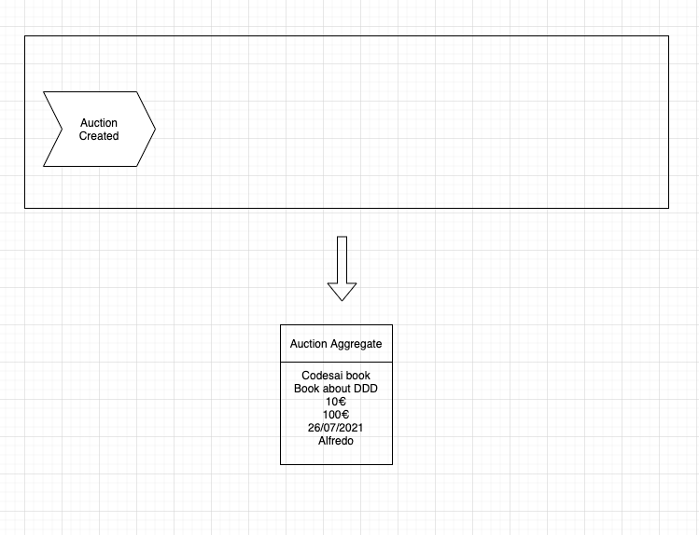
Event Sourcing: A visual representation

Slide 8
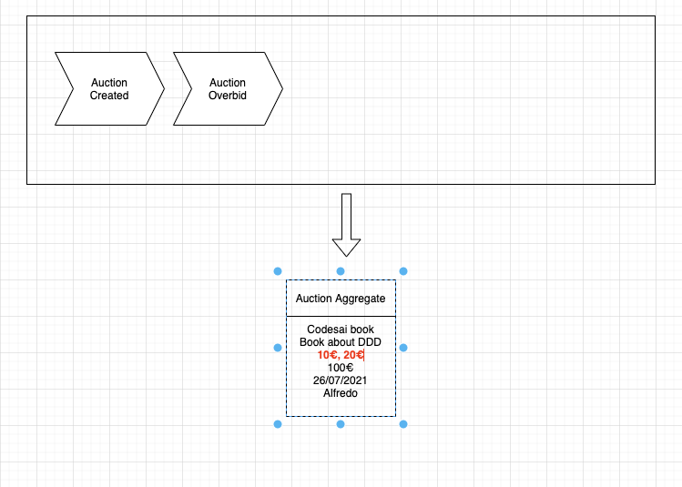
Event Sourcing: A visual representation

Slide 9
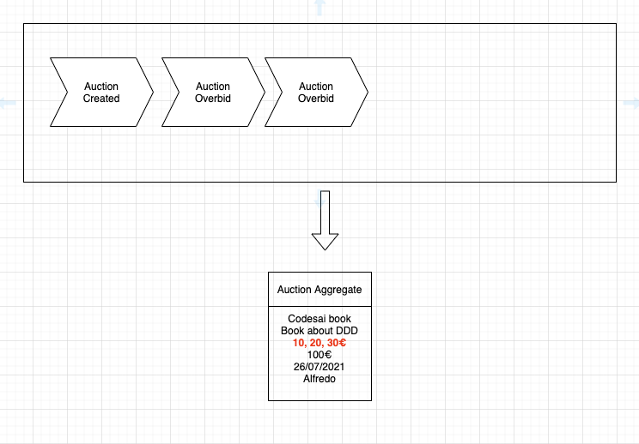
Event Sourcing: A visual representation

Slide 10
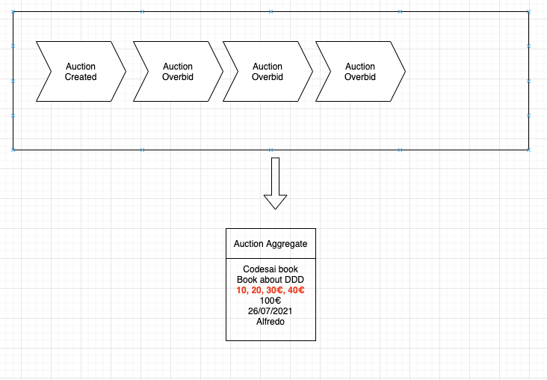
Event Sourcing: A visual representation

Slide 11
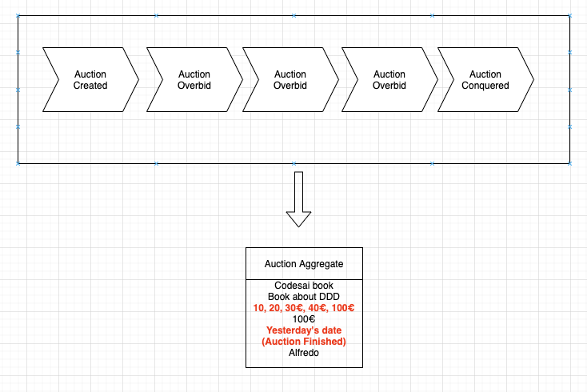
Event Sourcing: A visual representation

Slide 12
Event Sourcing: Advantages
Many systems are naturally Event Sourcing.
VCS (Git / SVN) , Bank Accounts, Social Networks, Chats, Logistics, Contracts Managements, etc...
Is pure transactional environment.
It is a safe way to store our data.
Append only oriented persistence, immutable data.
Persisted events are a powerful tool to debug or understand the flow an actor in our system.

Slide 13
Event Sourcing: Downsides
Versioning Events.
Eventual Consistency.
Is a double edge sword. More mobile parts to maintain. Pointing to snapshots and handling projections data.
Data batches size is multiplied.
Using CQRS is mandatory.

Slide 14
CQS: Command Query Separation
Created by Bertrand Meyer. It’s first reference comes in the first edition of Object-Oriented Software Construction
It’s a simple concept that separates the logic related to producing state changes and the one that read the state.
It’s the base concept that Greg Young’s CQRS builds on top of.

Slide 15
CQS: Command Query Separation
Commands (or Mutators): Triggers the system that mutates the current state (side effects). They are:
Idempotent
Void, they don’t return values
Queries: Return a result without changing the observable state of the system. Free of side effects.
The key idea is to separate the methods that change state from the ones that doesn’t.

Slide 16
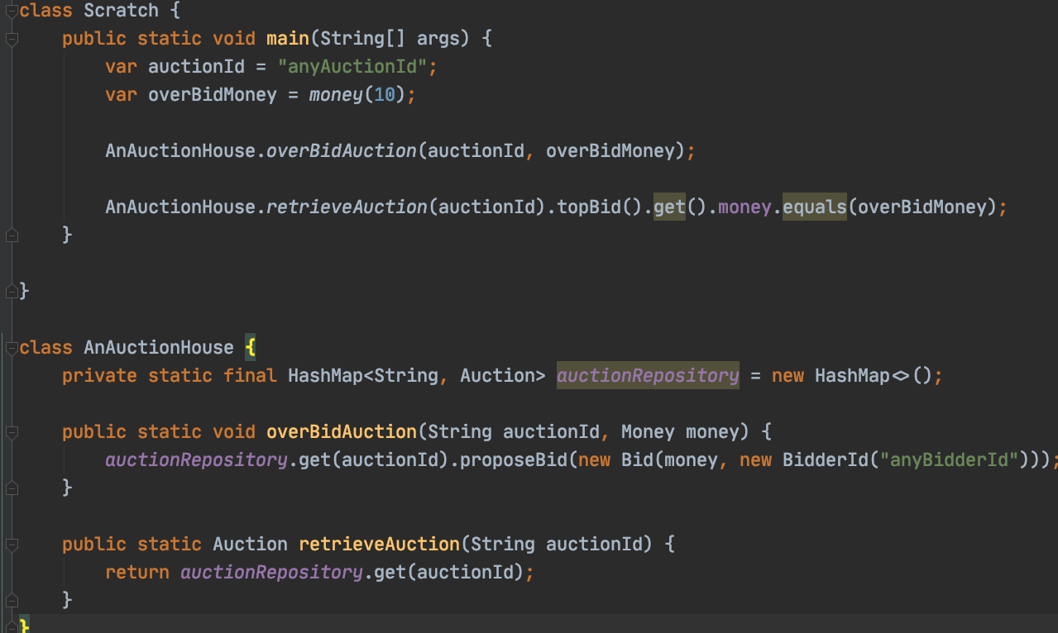
CQS: A practical example

Slide 17
CQRS: Command Query Responsibility Segregation
It’s a pattern that takes CQS one step further.
It segregates the commands and the queries logically within our domains.
Ie:
Objects
Files
Functional Interfaces
etc....
It serves the idea as an enabler to create fixed boundaries between commands and queries

Slide 18
CQRS: Command Query Responsibility Segregation
Usually the problems found on Command and Queries are diametrically opposed.
The commands faces consistency and stability in the data.
Queries faces scalability, availability and data impedance.
It’s common that software balance between write and read are 1% write tasks 99% reading taks.
Separating them in advance allow us to be more flexible in the future. Both technologically and business related iterations on the system.

Slide 19
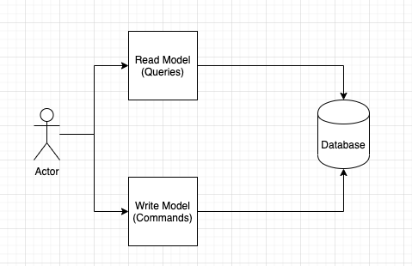
CQRS: Basic implementation

Slide 20
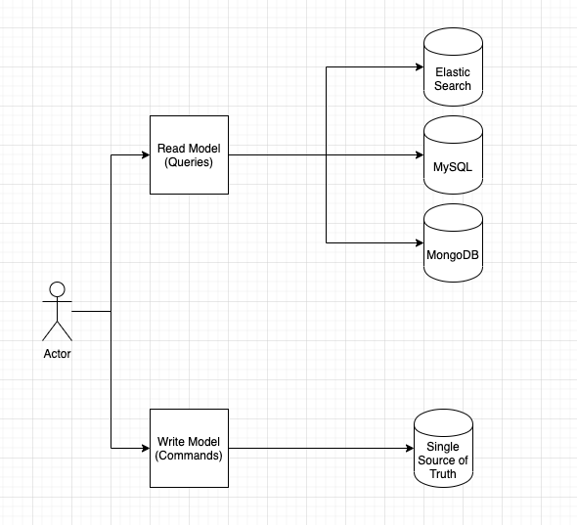
CQRS: Scaling Read Model

Slide 21
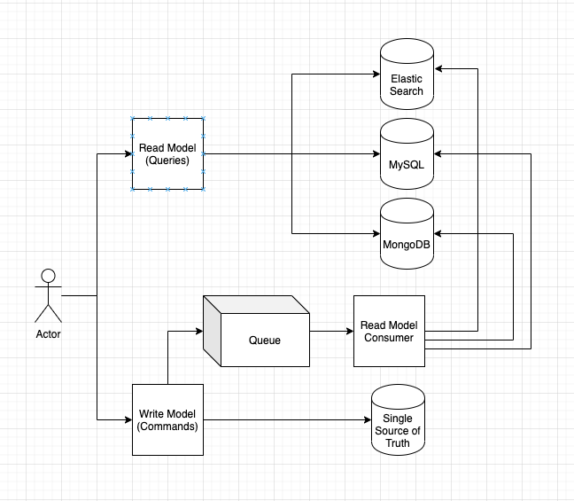
CQRS: Real Scaling Read Model

Slide 22
DDD Maturity Level ???
Level 1: Spaghetti Code
Level 2: Framework Lover
Level 3: Hexagonal Architecture
Level 4: Hexagonal Arch. + Domain Events
Level 5: Stepping Stone (CQRS w/o Event Sourcing)
Level 6: CQRS + Event Sourcing

Slide 23
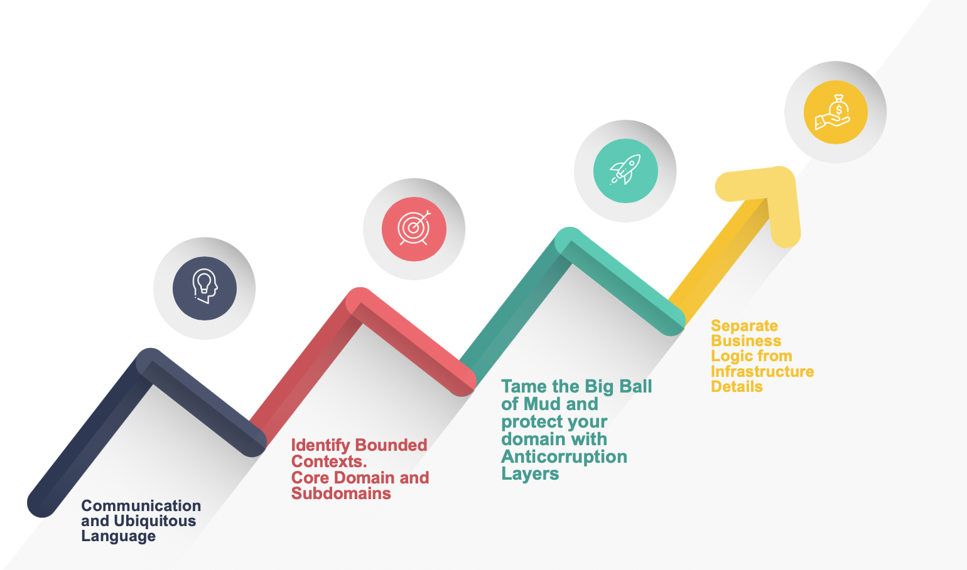
Organization Stepping Stones to succeed with DDD
And remember. Code is just inventory. Invest on communication and growing the knowledge of your domain and choose the technical solution that fits you best.

Slide 24
Beyond Tactical DDD. To the infinite and beyond
Greg Young's Blog
A Whole System Based on Event Sourcing is an Anti-Pattern
Greg Young - CQRS and Event Sourcing - Code on the Beach
Udi Dahan - If (domain logic) then CQRS, or Saga?
CQRS Documents by Greg Young
Versioning in an Event… by Gregory Young
Greg Young — A Decade of DDD, CQRS, Event Sourcing
Modern Software Architecture: Domain Models, CQRS, and Event Sourcing

